Slide 1
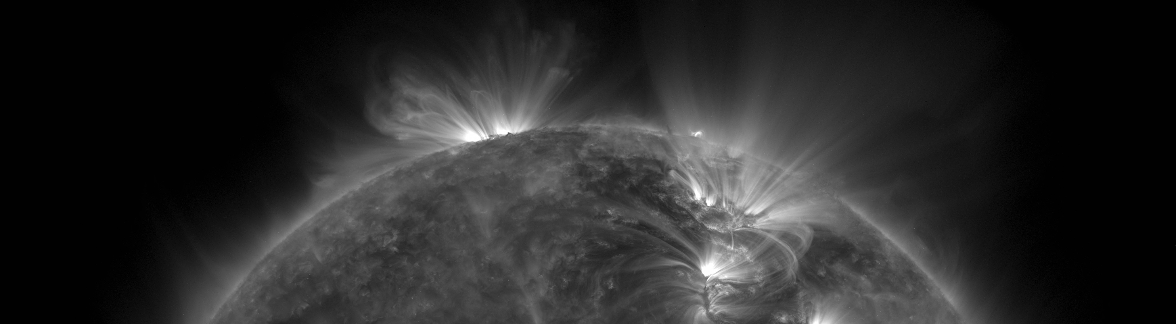
EUV Solar Telescope Using Fresnel Zone Plates
Roy Smart
EELE582 Optical Design
Montana State University
Notes:
Hi everyone, my name is Roy Smart and this presentation is about designing an extreme ultraviolet telescope using a unique type of lens known as a Fresnel zone plate.

Slide 2
Motivation
The solar atmosphere is often investigated by using extreme ultraviolet (10nm-124nm) telescopes.
Building optical systems in this regime is difficult since EUV photons are absorbed by all known elements.
Requires using space-based observatories
Current EUV imaging systems use multilayer reflective optics to focus light.
EUV multilayer optics are difficult to design and extremely expensive to produce.
Can we do better?
Notes:
In my lab, I study the sun in the extreme ultraviolet. This regime is important to studying the sun because it allows a glimpse into the dynamic structure of the solar atmosphere.
Since EUV does not propagate in the atmosphere, optical technology in this band is far behind that of visible. This is mostly due to the fact that no known material is transparent enough to EUV to be able to make a conventional lens out of it. EUV imaging capabilities rely on reflective optics, which require expensive and delicate multilayer coatings to achieve reasonable transmission. The question is, can we do anything to make the system better?

Slide 3
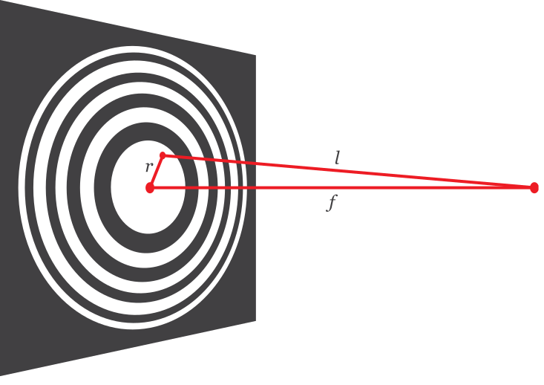
Introducing the Fresnel Zone Plate
Diffractive imaging system.
Plate is divided into zones, alternating between opaque and transparent.
Zones are placed such that incoming plane waves constructively interfere at the focus.
Good candidate for EUV imaging.

Slide 4
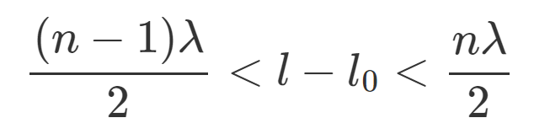
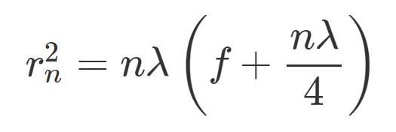
Fresnel Zone Plate Theory
The condition for constructive interference at the focus is
The radii where the zone plate switches from opaque to transparent is then

Slide 5
Fresnel Zone Plate Challenges
The location of the zones is wavelength dependent, leading to severe chromatic aberration.
Resolution of the zone plate is limited by the width of the smallest zone (diffraction limit).
Zone plates are often manufactured using lithography, which currently achieve 10nm spot-sizes.

Slide 6
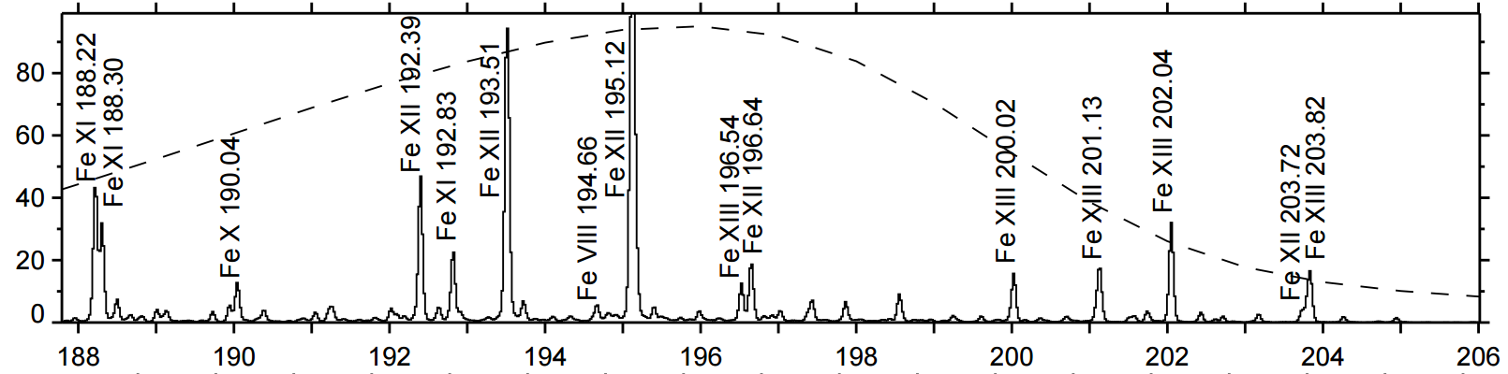
Solar EUV Telescope Requirements
Narrow passband
19.3nm to 19.5nm capturing two Fe XII emission lines
Narrow-band filter will not be modeled in Zemax, we will simply model the propagation of these two wavelengths.

Slide 7
Solar EUV Telescope Requirements
Narrow passband
19.3nm to 19.5nm capturing two Fe XII emission lines
Narrow-band filter will not be modeled in Zemax, we will simply model the propagation of these two wavelengths.

Slide 8
Solar EUV Telescope Requirements
Current observatories such as the Solar Dynamics Observatory (SDO) achieve sub-arcsecond (0.6”) resolution.
We would like to match this performance.
Full-disk imaging of the sun requires a 1900”x1900” (0.53x0.53 deg.) field of view.
Illuminating a ½” CCD requires a focal length f = (0.25in) / tan(950”) = 1373mm

Slide 9
Modelling a Fresnel Zone Plate in Zemax
Represent Fresnel zones by placing circular obscurations at the appropriate radii, optimized for 19.3nm.
Real zone plates can have thousands of zones, entering in each zone manually is not a option!
Use Zemax C++ programming interface to automate the creation of zones

Slide 10
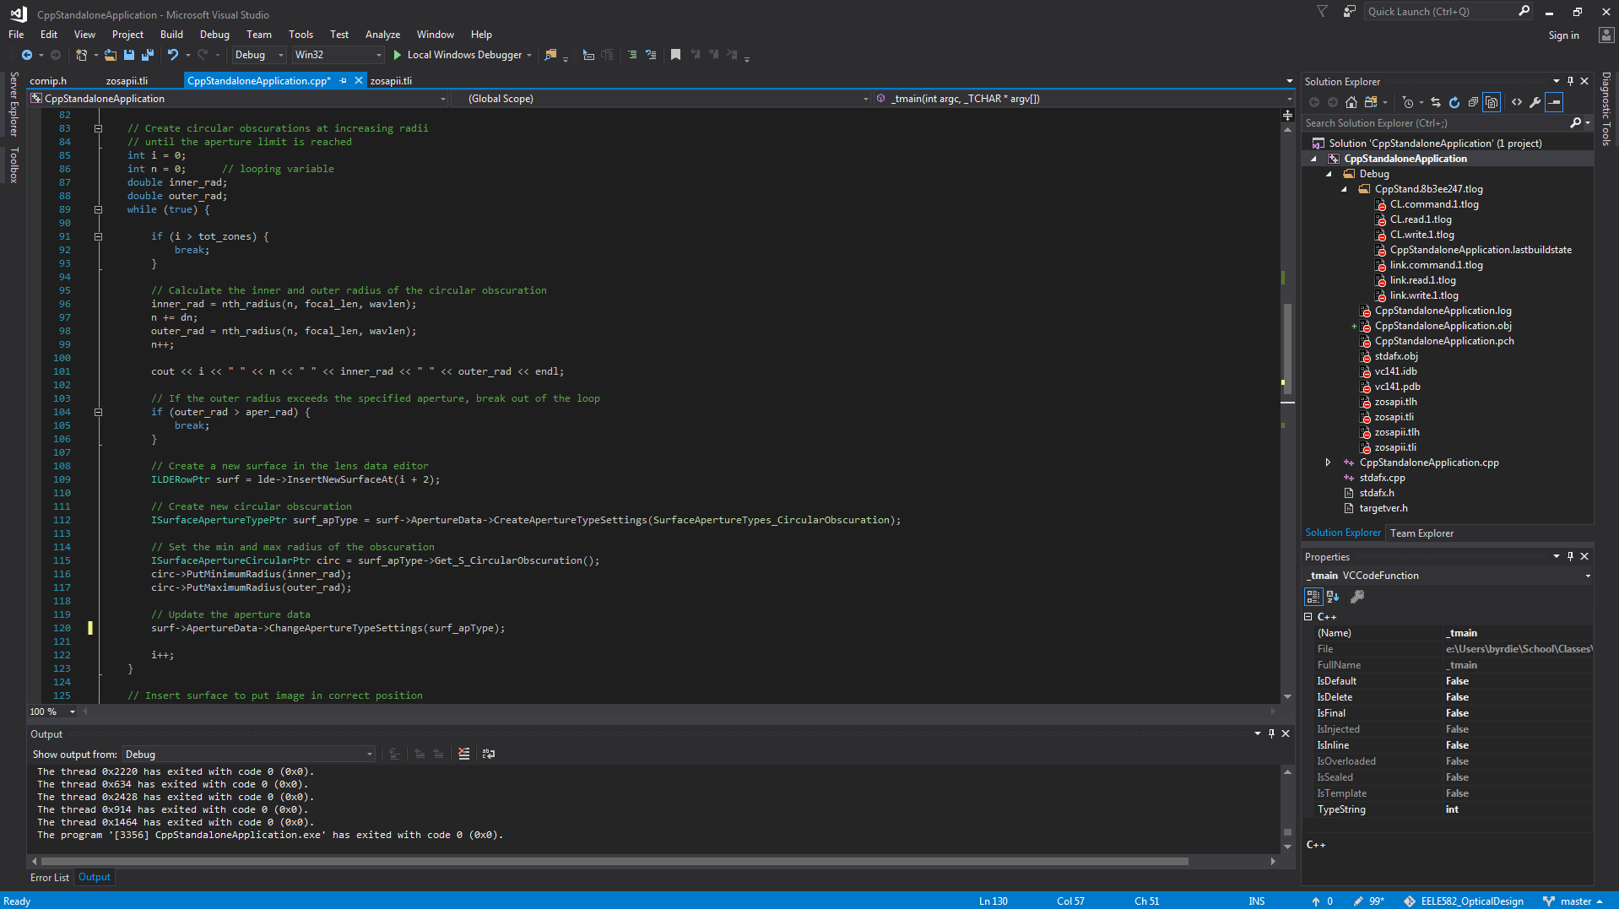

Slide 11
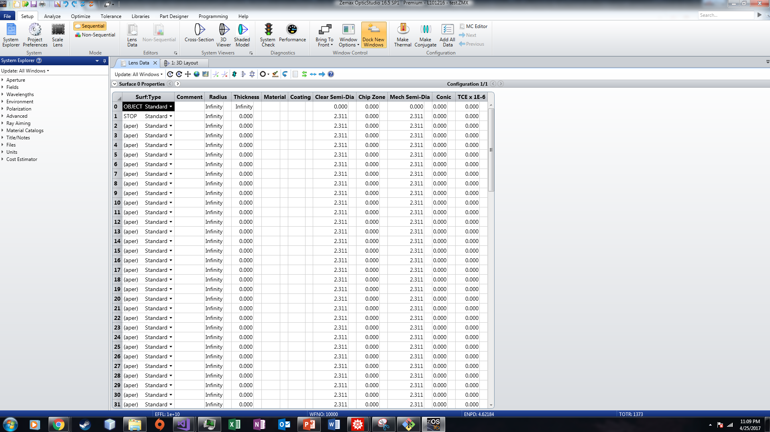

Slide 12
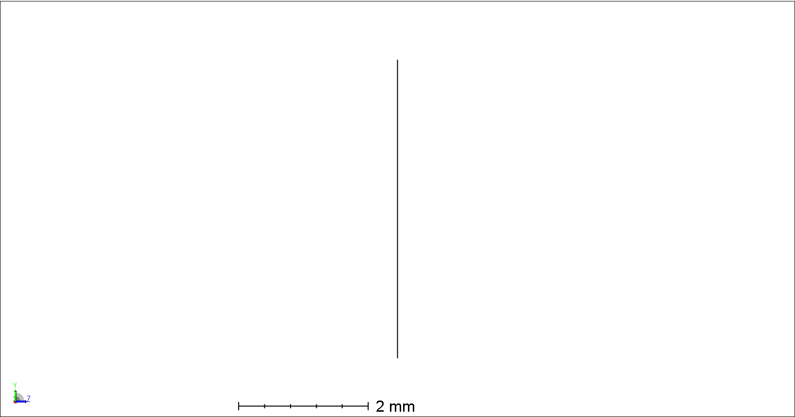

Slide 13
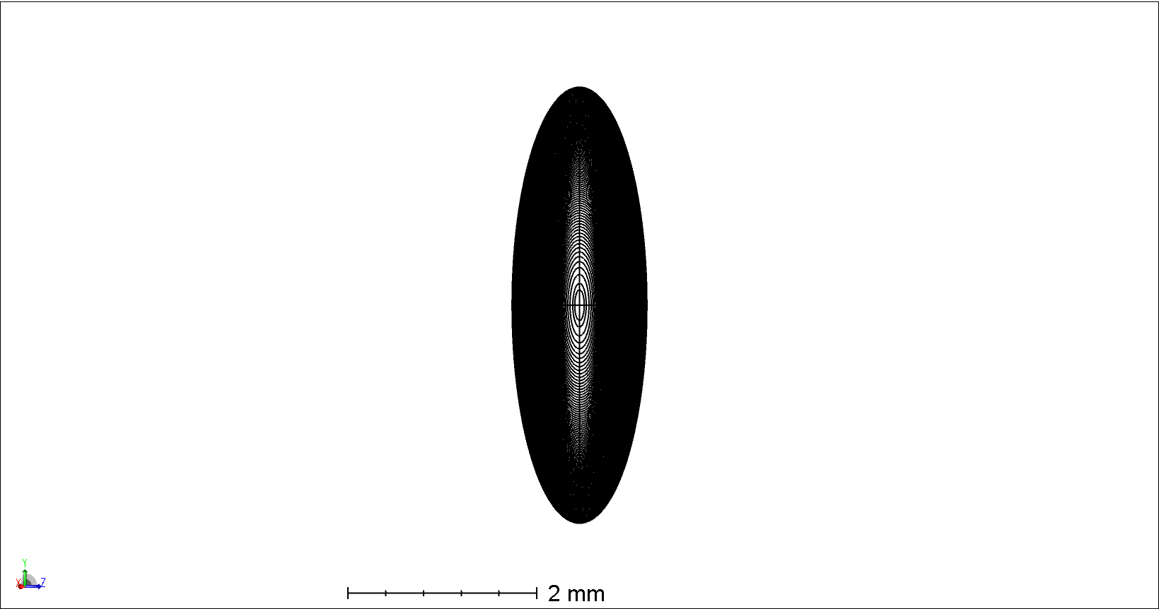

Slide 14
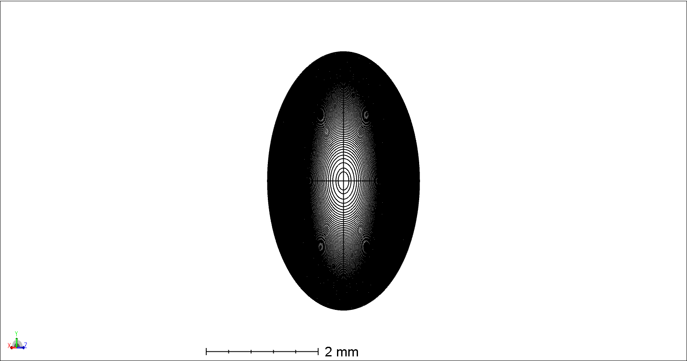

Slide 15
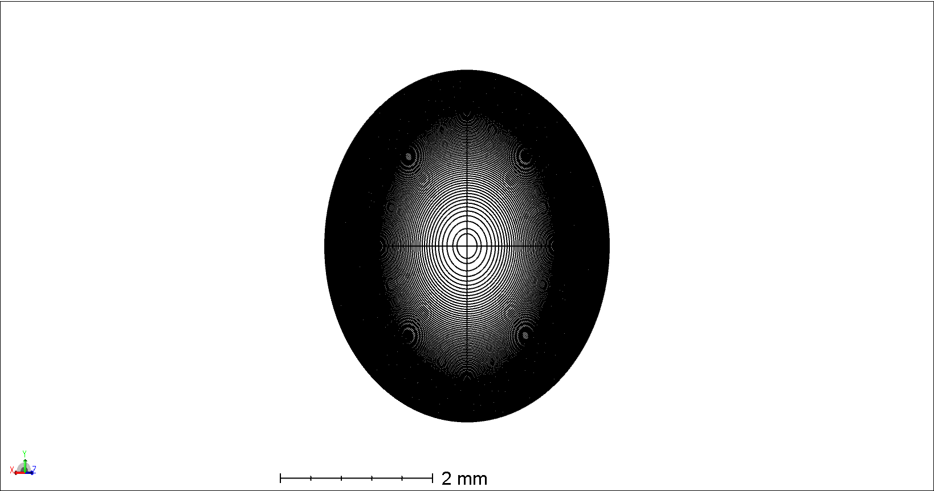

Slide 16
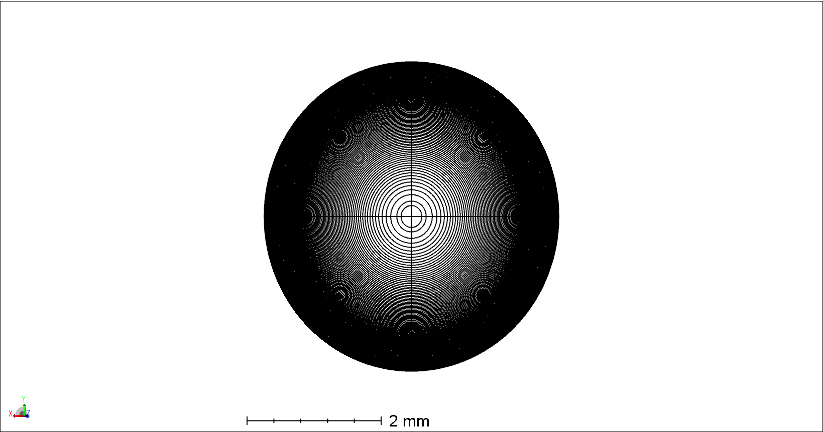

Slide 17
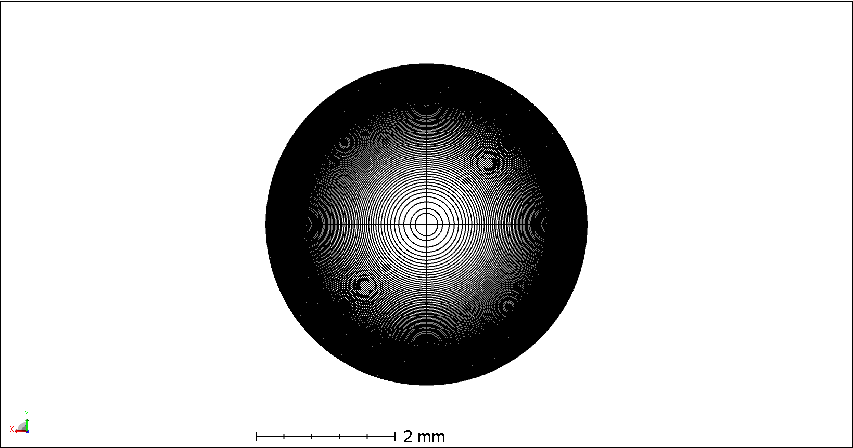

Slide 18
Modelling a Fresnel Zone Plate in Zemax
Represent Fresnel zones by placing circular obscurations at the appropriate radii, optimized for 19.3nm.
Real zone plates can have thousands of zones, entering in each zone manually is not a option!
Use Zemax C++ programming interface to automate the creation of zones.
Use Physical Optics Propagation (POP) to model the field after the zone plate.
The size of the POP grid determines how many zones we can represent. We certainly can’t represent more zones than grid points, and for accurate simulation we would like several points per zone.
For this project, we will use 100 zones on a 8192x8192 POP grid.

Slide 19
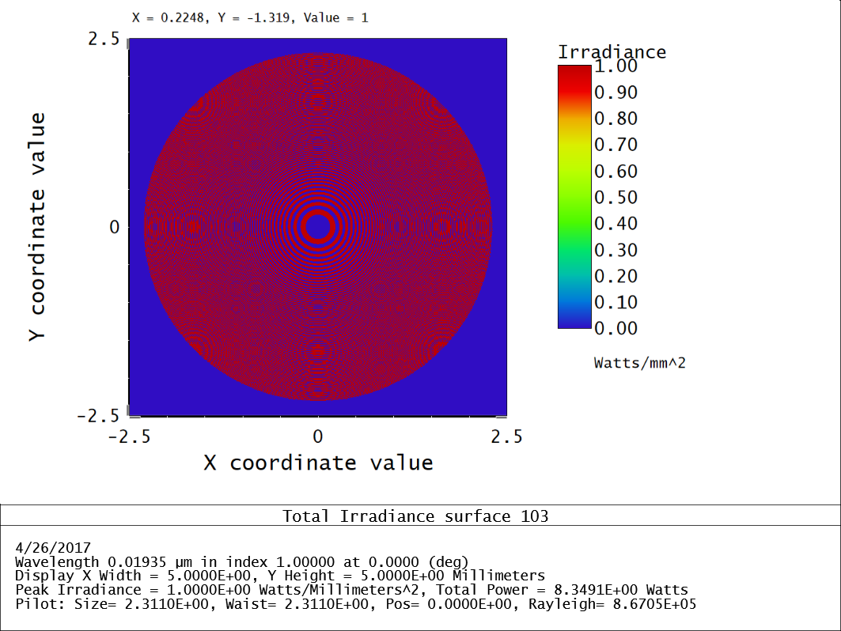

Slide 20
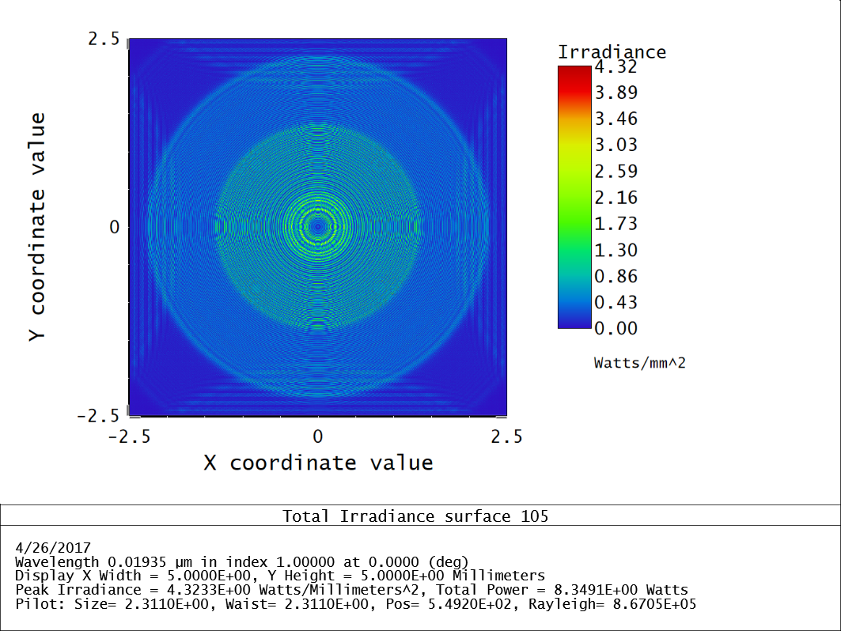

Slide 21
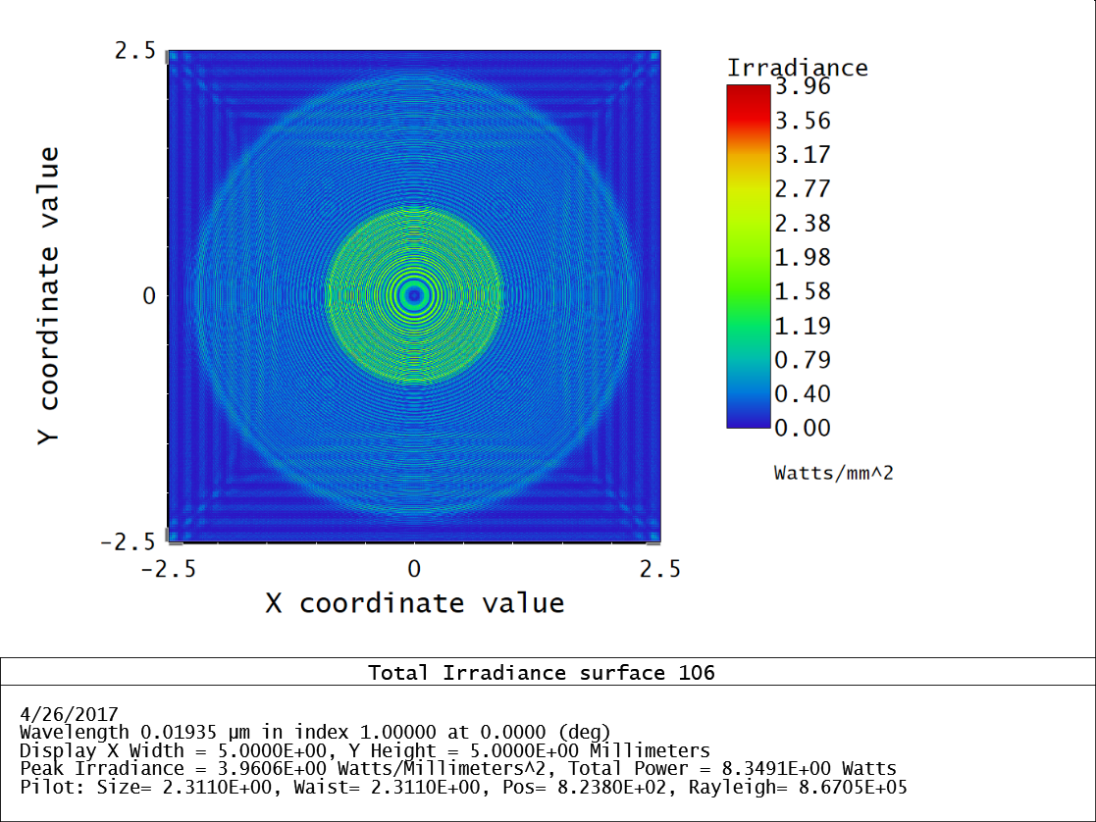

Slide 22
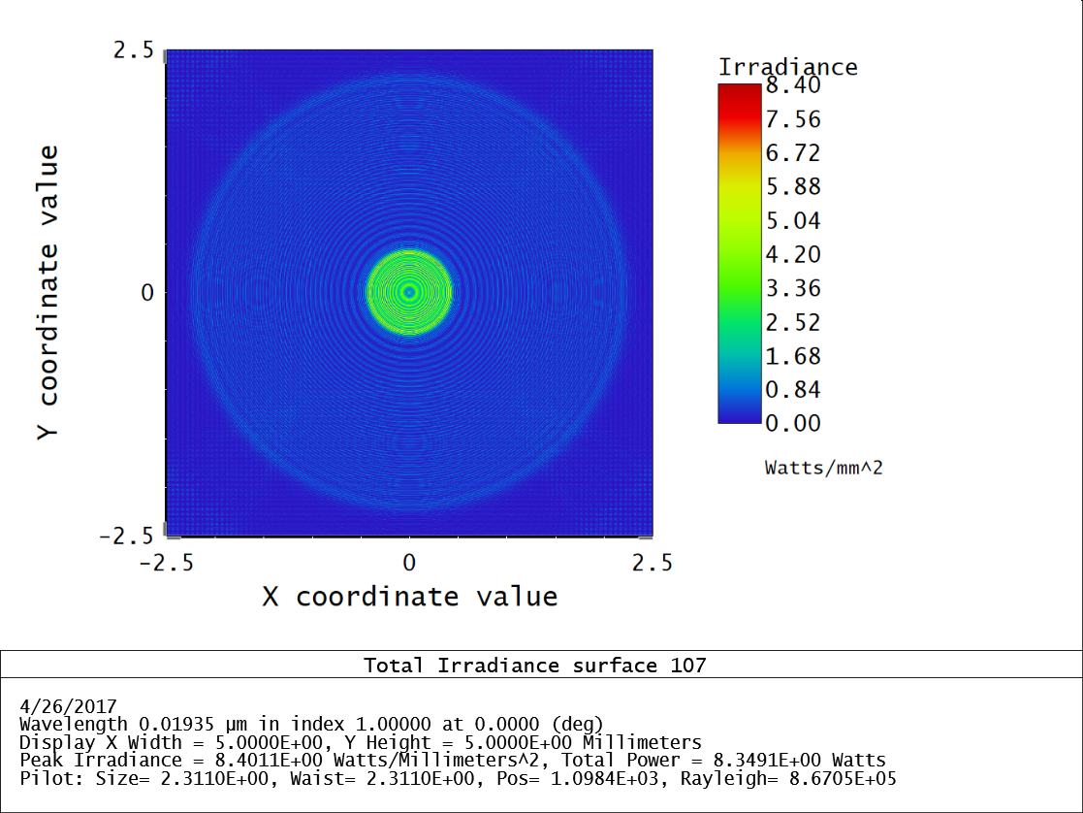

Slide 23
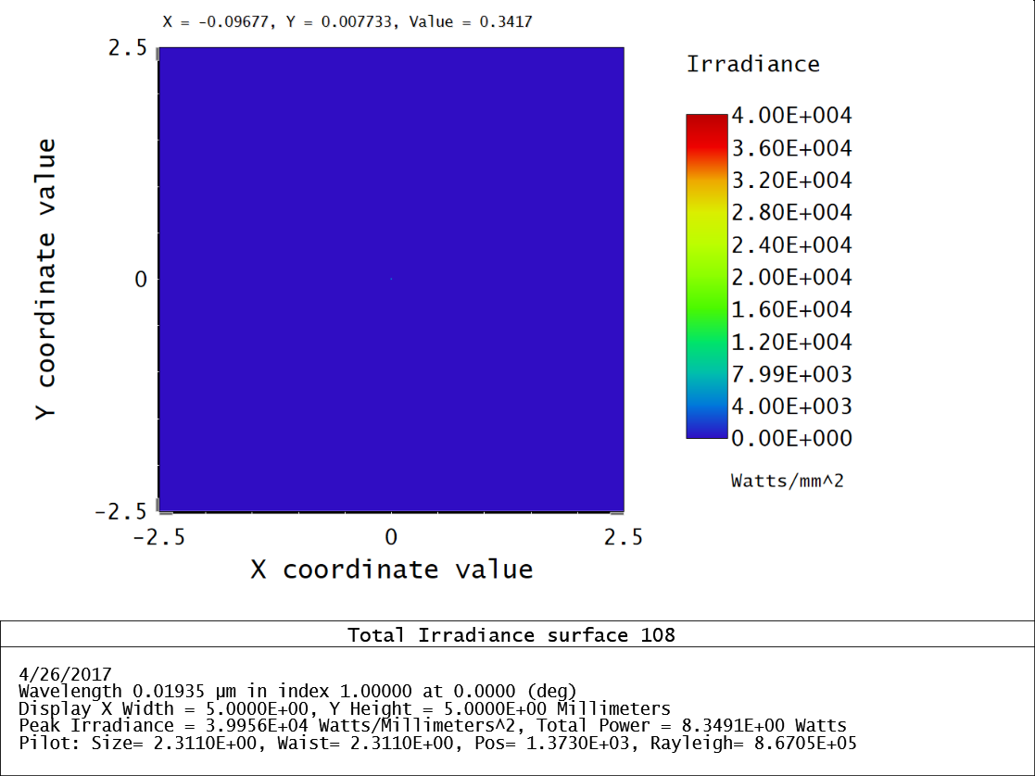

Slide 24
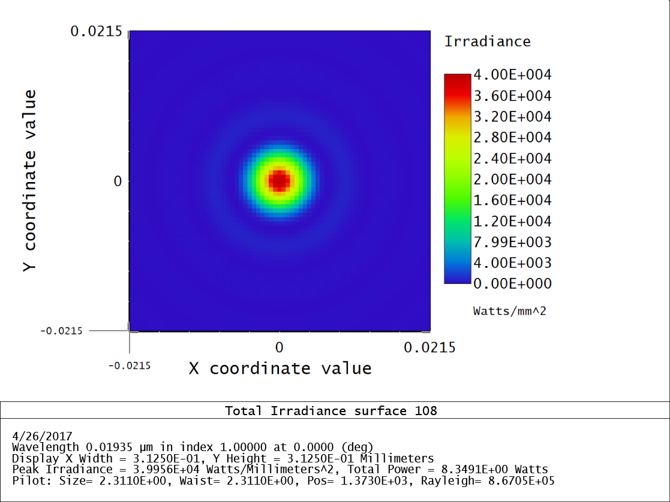
19.3nm Point-spread Function
Calculated from POP rather than Huygens or FFT.
Huygens and FFT PSF calculations were unstable.
Zone plate is optimized for this wavelength, therefore the PSF is diffraction limited.
No off-axis aberrations
Field curvature excluded from simulation

Slide 25
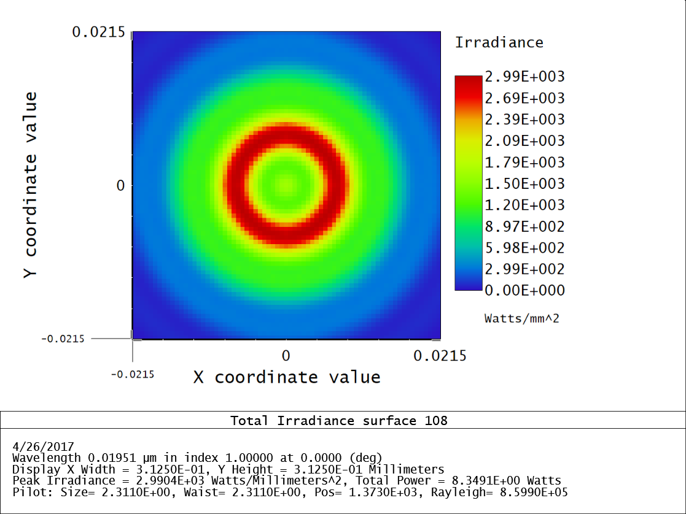
19.5nm Point-spread Function
Also Calculated from POP
Ring-shaped PSF
Not diffraction-limited
As with the 19.3nm PSF, there is no dependence on field angle

Slide 26
Image Simulation
Image simulation tool in Zemax used Huygens PSF for computations.
As mentioned before, the Huygens method is unsuitable in this scenario
Re-implemented the simulation tool in Mathematica
Convolves the PSF with some input image
Used the Zemax C++ API to export the data from the POP calculation to Mathematica.
Use SDO/AIA images to represent the sun.
171 Angstrom channel = 19.3nm component
193 Angstrom channel

Slide 27
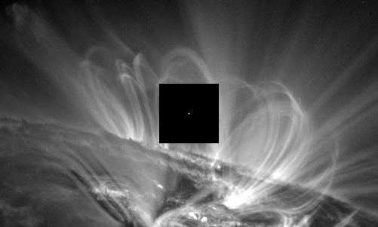
19.3nm – PSF Overlay

Slide 28
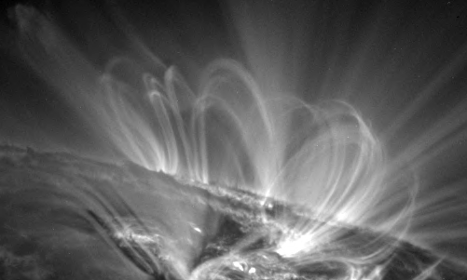
19.5nm - Original
19.3nm – Original

Slide 29
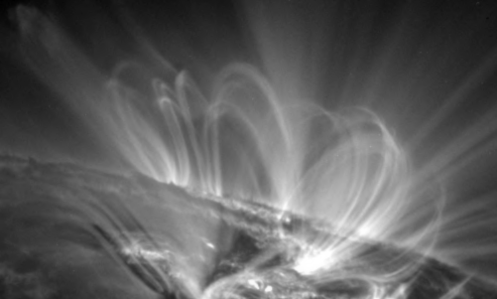
19.3nm – PSF applied

Slide 30
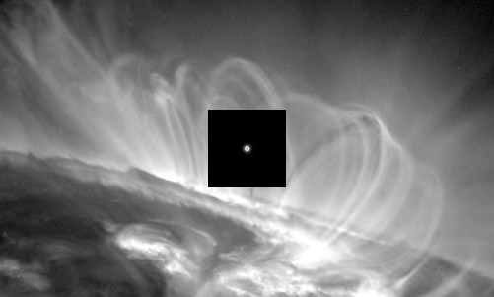
19.5nm – PSF Overlay

Slide 31
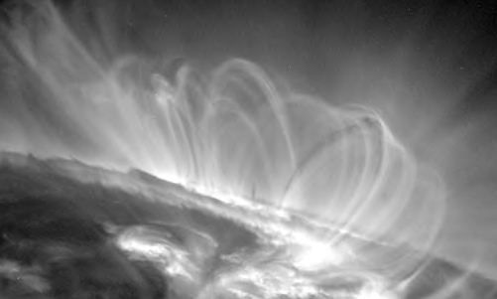
19.5nm - Original

Slide 32
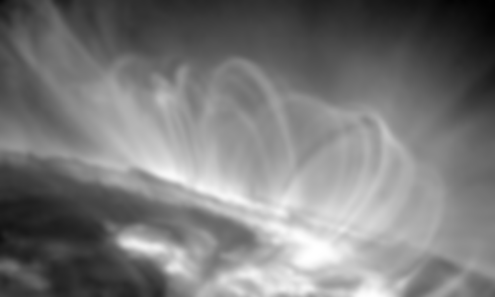
19.5nm – PSF applied

Slide 33

19.3nm + 19.5nm – Observation

Slide 34
Conclusion
Investigated the use of zone plates in solar EUV astronomy.
Chromatic aberrations introduced by zone plate imaging were quantified and compared to current EUV imaging capabilities
To provide good imaging over some passband, one could imagine building an array of zone plates.
Each sensor would be placed in a slightly different locations corresponding to the focus of some spectral line.
Computational inversion algorithms would then be used to eliminate the chromatic aberration.

